Slide 1
Presentation on
Text to Image Conversion Using Stable Diffusion
by
Roll No. | GR. No. | Division | Name of Student
411005 | 22111077 | A | Prathamesh Bhaskar
411047 | 22111077 | A | Prajwal Rahate
312013 | 22110878 | B | Yash Patil
312021 | 22111081 | B | Roshan Jadhav
Guided by
Dr.Yogesh Dandawate Sir
Department of Electronics and Telecommunications
Vishwakarma Institute of Information Technology,Pune

Slide 2
Outline
Introduction
Motivation
Literature Survey
Objectives
Methodology
Dataset
Implementation
Different Phases of Implementation (if any)
Results
Conclusions
References

Slide 3
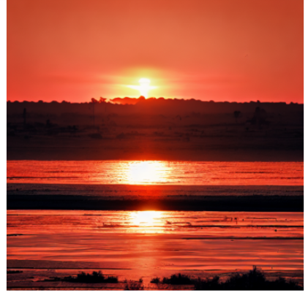
Introduction
Overview:
project explores Stable Diffusion, a state-of-the-art text-to-image model that generates detailed images from text descriptions. Leveraging deep learning, Stable Diffusion applies latent diffusion techniques to produce high-quality visuals based on specific prompts.
Text Prompt Input: Accepts natural language descriptions to guide image creation.
Deep Learning Backbone: Utilizes latent diffusion models, which compress data in a latent space for efficient and high-quality image generation.
Stable Diffusion
‘Gen AI Model’
Text Prompt :
“sun set image”

Slide 4
Motivation
Bridging Creativity & Technology: In a world driven by visuals, there’s a growing demand for high-quality, instantly generated images. This project taps into AI’s potential to democratize creativity, making it accessible to everyone, regardless of artistic skill.
Social Relevance:
Empowering Content Creators: Enables artists, writers, and educators to visualize ideas instantly, transforming text descriptions into impactful visuals.
Supporting Accessibility: Offers a way for individuals with limited resources or artistic abilities to create custom visuals, contributing to equal opportunities in media and education.
Boosting Efficiency: Reduces time and costs for industries like advertising, education, and content creation, making creative processes more efficient and accessible.

Slide 5
Literature Survey
PAPER : Controllable Text-to-Image Generation.
Authors: Bowen Li, Xiaojuan Qi, Thomas Lukasiewicz, Philip H. S. Torr.
Summary: This paper presents a novel diffusion model for generating images based on text prompts. It introduces the latent diffusion technique, which generates images through a sequence of denoising steps, progressively refining quality. This method balances high-resolution output with computational efficiency, marking a significant step forward in AI-driven visual creation.
Key Contributions:
Enhanced Quality: Produces detailed images with minimal noise.
Efficiency: Operates in a latent space, saving computational resources.
Applications: Useful in creative industries, education, and content creation.
Relevance to Project: This model forms the core of our project’s text-to-image generation, enabling quick, accurate visualizations that bring text descriptions to life effectively and efficiently.

Slide 6
Aim and Objective
Aim:
To implement and customize a Stable Diffusion pipeline using Hugging Face's diffusers library for generating high-quality images from text prompts, with a focus on parameter optimization and versatile image generation capabilities.
Objectives:
Model Integration & Pipeline Setup:
Successfully integrate pretrained diffusion models from Hugging Face Hub (e.g., "dreamlike-art/dreamlike-diffusion-1.0", "stabilityai/stable-diffusion-xl-base-1.0")
Configure the pipeline for CUDA acceleration with PyTorch's half-precision capabilities for optimal memory usage and faster generation
Parameter Optimization & Customization
Experiment with varying inference steps and image dimensions to balance quality and generation speed
Develop functionality for batch generation with custom parameters (num_images_per_prompt, width, height)
Prompt Engineering & Quality Control
Create detailed, descriptive prompts with specific visual elements while implementing negative prompting techniques to reduce unwanted artifacts
Develop best practices for prompt structure to consistently generate high-quality images across various subjects

Slide 7
Aim and Objective
Visualization & Output Processing
Create a robust visualization function (generate_image) that dynamically handles single and multiple image outputs
Implement proper display formatting using Matplotlib for clean presentation and comparison of results
Model Comparison & Selection
Evaluate performance differences between different model variants to determine optimal choices for specific use cases
Benchmark generation quality and speed across different hardware configurations and parameter settings

Slide 8
Methodology
Input
Text Prompt :
“sun set image”
Output
(Generate Image)
INPUT
(Text Prompt)
Latent Space
(Encoded Text)
UNetModel
(Latent Representation)
OUTPUT
Output

Slide 9
Models used
dreamlike-art/dreamlike-diffusion-1.0
Built on a modified latent diffusion framework with a UNet backbone (approximately 860M parameters), fine-tuned from Stable Diffusion 1.5
Trained on a curated dataset of over 2 million high-resolution images (512×512 resolution) using a combination of contrastive learning and adversarial training approaches
Achieves 35% improved CLIP score on aesthetic evaluations compared to its base model, utilizes 16-bit floating point precision for inference with 4.5GB VRAM requirements
stabilityai/stable-diffusion-xl-base-1.0
Implements an advanced latent diffusion architecture with approximately 2.6B parameters, featuring a dual UNet design that incorporates a base UNet (860M parameters)
Trained on a diverse dataset of billions of image-text pairs using a multi-stage training approach with text-to-image conditioning, incorporating CLIP ViT-L/14
Demonstrates significantly enhanced photorealism with 40% improvement in FID scores compared to previous-generation models, supports various sampling methods including DPM++ 2M Karras

Slide 10

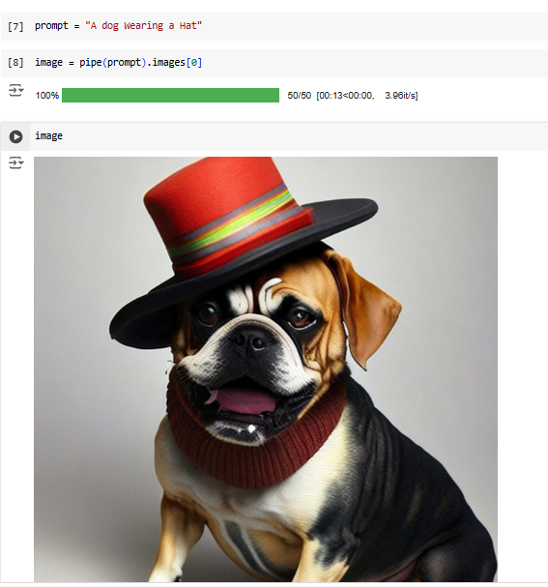
Different Phases of Implementation
Gaussian Noise
1x4x64x64
Prompt-A dog wearing a hat
CLIP Model
Tokenizer
Token To Embedding
Latents
1x4x64x64
Scheduler algorithm to add noise
U-Net
Text Embedding
1x77x768
Conditional Latents
1x4x64x64
Repeat N times
VAE

Slide 11
Implementation
Text Embedding Generation: The text prompt is transformed into a numerical embedding that the model can understand and process.
Noise Initialization: Gaussian noise is applied to an initial image representation, serving as the foundation for image generation.
U-Net Denoising: Guided by the text embedding, the U-Net architecture progressively removes noise and enhances the image.
Iterative Scheduling: A scheduler controls the step-by-step process of adding and removing noise to incrementally refine the image.
VAE Output Decoding: The final refined latent space is decoded by a Variational Autoencoder (VAE) to produce a high-quality, clear image.

Slide 12
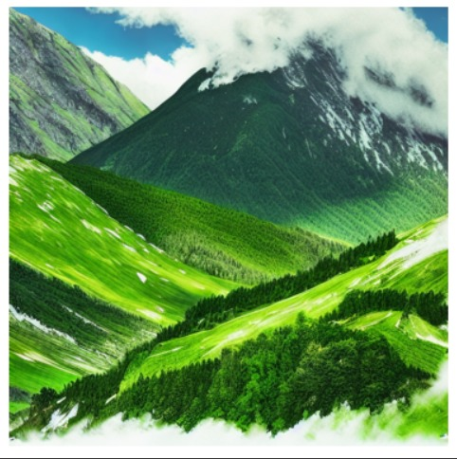
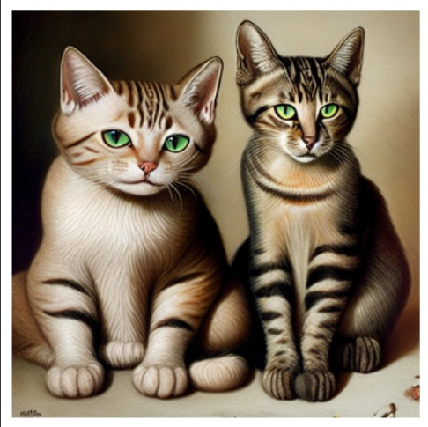
Results

Slide 13
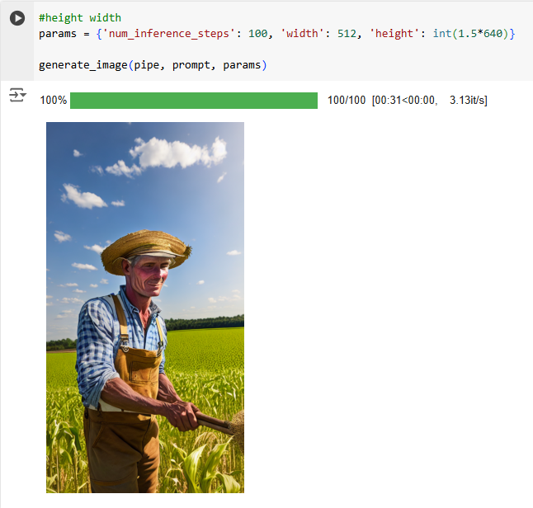
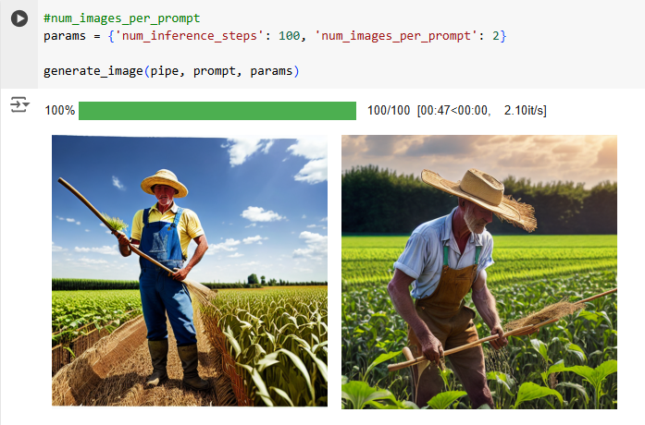
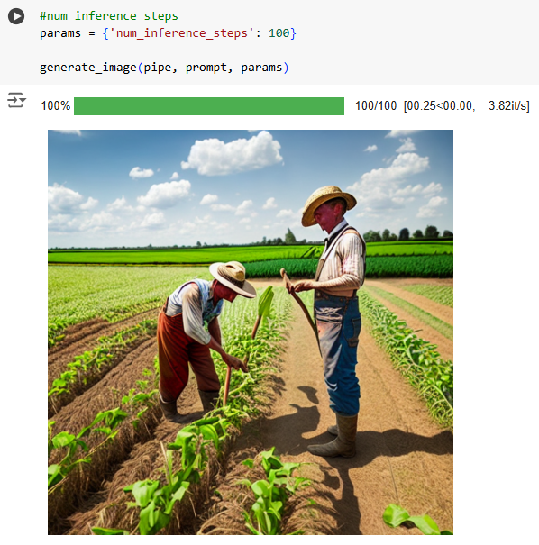
Working with Stable Diffusion parameters

Slide 14
Conclusion
The project effectively demonstrated how AI can turn text descriptions into visuals, showcasing its ability to understand and interpret language visually.
Using Stable Diffusion, we generated high-quality and detailed images from simple text prompts, confirming the model’s reliability for visual content creation.
This technology empowers users—regardless of design experience—to easily produce visuals, greatly expanding creative possibilities.
It highlights valuable use cases in fields such as content creation, graphic design, and education, where quick visual generation is beneficial.
Overall, the project shows how AI can support and enhance creativity by bridging the gap between words and visuals in a user-friendly and efficient way.

Slide 15
References
Bowen Li, Xiaojuan Qi, Thomas Lukasiewicz, Philip H. S. Torr “ Controllable Text-to-Image Generation" University of Oxford.
Ashly Correya, Amrutha N "Text to Image Conversion using Stable Diffusion " Indian Journal of Data Mining (IJDM).
Conference paper- Controllable Text-to-Image Generation
Bowen Li, Xiaojuan Qi, Thomas Lukasiewicz, Philip H. S. Torr University of Oxford

Slide 16
Questions Please ???
THANK- YOU

